Slide 1
HCI notes

Slide 2
Design Process
Requirements
Principles
Design
Analyse Data
Implement & deploy
Heuristic Evaluation
Research Methods
Architectures
Documentation
Help
Prototype
Choose participants
Conducting a study
Ethics and Consent
Design Study

Slide 3
Identify the Problem(s)
Interviews
Unstructured
Focuses on uncovering the problem(s)
Lots of data but challenging to analyse, impossible to replicate
Structured
Focuses on uncovering the cause, can be done by anyone or a computer
Easy to replicate
Easy to compare data across a wide range of individuals, but
No discussion, cannot follow up
Semi-structured
Focuses on uncovering the cause(s)
Structured questions that can be followed up on, but
Might still miss some key ideas
Diary studies
Select someone/somewhere that acts as a common meeting point for the group you’re interested in
Helps eliminate memory bias – people forgetting small details that might be important to you

Slide 4
How to Conduct an Interview
Structure
Overview
What the study is, purpose, reassure that it is not an evaluation but learning from them
Notification and consent
Show awareness of ethical and privacy issues
Simple questions to start
Main interview
Thank the participant
Things to note
Focus on the participant, not yourself
Ensure everything is clear and unambigious, and topics that they know about
Do not ask them to design a system for you

Slide 5
Contextual Inquiry
Going to the interviewee’s space to conduct an interview
Pros
Richer data
Eliminate memory bias or bias toward what is considered ‘normal’
See problems first-hand
Cons
Takes up time, less interviews can be conducted
May require special permission
Less structured data is harder to analyse

Slide 6
Design Process
Requirements
Principles
Design
Analyse Data
Implement & deploy
Heuristic Evaluation
Research Methods
Architectures
Documentation
Help
Prototype
Choose participants
Conducting a study
Ethics and Consent
Design Study

Slide 7
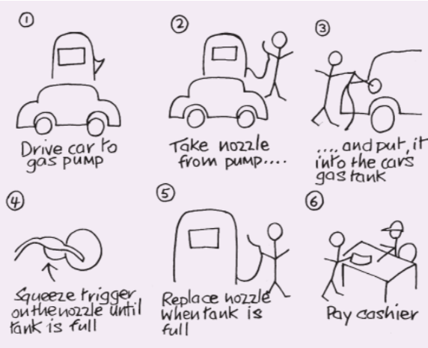
Design – Initial Phase
Storyboards
A series of sketches showing how a user might use the product
Pros
Simple, able to do by yourself
Makes you think through the process and identify ideas or problems
Useful way of communicating initial ideas to others
Cons
Limited space, cannot encompass the whole project
Design fictions
A short story explaining how you envision your app to be used
Similar to storyboarding, but without the drawings and purely with words

Slide 8
Design – Intermediate Phase
Card sorting
Put several ideas, concepts or things on cards and ask users to sort the cards into groups
To understand how users group concepts naturally
Useful for naming menu items, sorting lots of information into categories
Pros
Easy to explain, easy to run
Can understand how different groups of people could perceive something differently
Cons
Must know what to group together
Not possible for certain categories of things
Design patterns
Solutions to common design issues
Pros
Good way to not reinvent solutions, learn from others’ mistakes
Cons
Only common things have patterns
Not one size fits all, might not be applicable
Design Workshop
A small group of participants collaborate on an initial design
Pros
Create innovative solutions
Develop a culture of innovation
Cons
A lot of work needed to design and run a good workshop
Participants’ skills may vary widely
Outcomes might be difficult to interpret, not useful

Slide 9
Design – Human Perception
Visual perception
How our eyes work
Most detail in the center, blurry on the edges
Peripheral vision detects motion; unmoving objects with muted colour mostly go undetected
Humans are good at pattern matching
Matching unknowns to knowns
Spatially grouping information
Implications on design
Make things visible by
Putting messages where users are looking
Using an error symbol
Reserve red for errors
Pop-up messages (use sparingly)
Making use of sound (use sparingly)
Have icons wiggle or blink briefly (use sparingly)
Peripheral ‘pop’
Make use of ‘pop’s: in colour, boldness, visual hierarchy, headings, titles, etc
Design easily identifiable icons
Make more important things more prominent
Group related items together, visually nest nested items
Mental perception
Based on the past (experience)
Perceptual priming
Previous exposure to something unconsciously influencing us
Familiar perception patterns
Repeated exposure builds a pattern we expect to see
Habituation
Dulled sensitivity to certain things
Attentional blink
Brain occupied processing the first instance, ‘blinks’ and misses a second instance
Based on the present (context)
Based on the future (our goals)
Filters out what we don’t want to see
Implications on design
Avoid ambiguity
Be consistent
Understand users’ goals

Slide 10
Design – Principles of Design
Designing text
Use familiar vocabulary
Avoid difficult scripts or typefaces
Includes avoiding all caps, weird fonts, etc
Avoid too small fonts
Avoid noisy backgrounds
Avoid burying information in repetition
Avoid centering large chunks of text
Designing widgets/icons
Use affordances and metaphors
Affordance: properties of an object that help people know how to use it
eg buttons
Metaphors: matches real-world objects
eg pause/play symbols, eraser symbol

Slide 11
Design – Principles of Design
7 Gestalt Principles
Proximity
The relative distance between objects affects our perception of their organisation
Similarity
Objects that look similar appear grouped
Continuity
We add in missing data when there is ambiguity to connect disconnected pieces
Eg when designing a scrollbar, we don’t see 3 segments but one continuous bar
Closure
Our brains automatically close open figures/incomplete shapes
Symmetry
We parse complex images to reduce complexity and see the simplest shape
Figure/Ground
We try to separate images into foreground and background
Eg watermarks, background images
Common fate
Things moving in a similar manner appear grouped

Slide 12
Design Process
Requirements
Principles
Design
Analyse Data
Implement & deploy
Heuristic Evaluation
Research Methods
Architectures
Documentation
Help
Prototype
Choose participants
Conducting a study
Ethics and Consent
Design Study

Slide 13
Evaluation – Heuristic Evaluation
Heuristics – rules that are generally true, used to detect usability issues
Heuristic evaluation
Have one or more experts evaluate an interface using a common set of criteria
Pros
Can be done by one person, no ethics or privacy problems
Can find a potentially large number of problems
Cons
Experts =/= end users, might miss out some things
Heuristics might not cover all problems
Informal heuristic evaluation
The researcher uses the product as an end-user would
Formal heuristic evaluation
A group of experts who are briefed
Each works separately to identify problems
Debrief session where everyone works together to prioritse problems found
Nielson: “on average, 5 evaluators identify 75-80% of usability problems”, although it depends on context and nature of problems
Usability Aspect Reports (UAR)
A report specifying good and/or bad features linked to heuristics, investigating usability

Slide 14
Evaluation – Heuristic Evaluation
Nielson’s 10 Heuristics
Visibility of system status
Showing the user feedback of actions
Match between system and the real world
Use familiar conventions, language etc
User control and freedom
Allow for undos, exits, not forcing the user into a particular series of actions
Consistency and standards
Be consistent in expressing information and use normal conventions
Error prevention
Predict errors and show feedback to users before they make any
Recognition rather than recall
Flexibility and efficiency of use
Have ways to work more efficiently to allow for different levels (i.e. expert vs beginner)
Aesthetics and minimalist design
Help users recognise, diagnose and recover from errors
Clear error messages that explain the problem and proide a solution
Help and documentation

Slide 15
Design Process
Requirements
Principles
Design
Analyse Data
Implement & deploy
Heuristic Evaluation
Research Methods
Architectures
Documentation
Help
Prototype
Choose participants
Conducting a study
Ethics and Consent
Design Study

Slide 16
Designing a Study
Define “usable”
Identify requirements through interviews, surveys, etc
Make specific and easily identifiable goals to describe system’s usability
Identify the variables
Dependent variables
What you want to measure; measure of usability goal
Independent variables
Anything directly manipulated or controlled in the study
Any pre-existing feature of the participants
Set up the study
Comparing between subjects, or within subjects (before/after)?
Scripted, or observational?
Evaluate the outcome
Numeric data
Continuous, discrete, or interval (each possible value is equidistant)
Categorical data
Binary (2 possibilities), ordinal (ordered eg high, med, low), or nominal (cannot be ordered)

Slide 17
Design Process
Requirements
Principles
Design
Analyse Data
Implement & deploy
Heuristic Evaluation
Research Methods
Architectures
Documentation
Help
Prototype
Choose participants
Conducting a study
Ethics and Consent
Design Study

Slide 18
Conducting a Study – Ethics and Consent
Following the infamous Tuskegee Syphilis study that ended in 1972, The Belmont Report (1974) was released, followed by the Menlo Report (2012)
4 ethics principles
Respect for persons
Informed consent
Courtesy
Beneficence
Do no harm
Risk-benefit analysis: try your best to minimise risks
Justice
Equal distribution of costs and benefits to all
One method: randomly select participants from target population
Respect for law and public interest
Compliance to the law
Transparency and accountability
Before: Make contents clear, communicate risks
After: Make the results of the study public
Consent
Implicit and explicit (focus on explicit)
Starts at advertisments; being transparent
Consent form that communicates rights, risks, and compensation

Slide 19
Design Process
Requirements
Principles
Design
Analyse Data
Implement & deploy
Heuristic Evaluation
Research Methods
Architectures
Documentation
Help
Prototype
Choose participants
Conducting a study
Ethics and Consent
Design Study

Slide 20
Conducting a Study – Participants
Why involve users?
Share control (democratisation)
Share expertise
More accurate user requirements, more effective
Avoid costly features the user does not want
Inspire change (to your solution)
Increase level of acceptance
How to involve users
User-centered design (designing for users)
Participatory design (designing with users)
Informant design (somewhere in between; involved at certain stages, offer input and feedback)
External validity
Generalisability of information learnt to the target population
The more control, the less outside influence, but the less generalisable the results
Things that limit external validity listed under “limitations” section of report
Selecting participants
Find people who are as representative as possible/understand the problems of user group
Either users themselves, or experts on the users
Early evaluation on less-expensive group, final evaluation with more representative group

Slide 21
Design Process
Requirements
Principles
Design
Analyse Data
Implement & deploy
Heuristic Evaluation
Research Methods
Architectures
Documentation
Help
Prototype
Choose participants
Conducting a study
Ethics and Consent
Design Study

Slide 22
Conducting a Study – Research Methods
Research methods
Paper Prototyping
Think Aloud
Cognitive Walkthrough
Lab Study
Focus Groups
Survey
Interview (slide 5)
Tasks
High level
Includes a state the user wants to achieve
Subtasks
Lower level, divides the task into smaller parts
Personas
Short biography about a fictitious user
Helpful in explaining the target user to others, gives context to who the participant should be
Paper prototyping
Printing your prototype screens on paper, and asking for feedback on the exact screen
Useful when designing or modifying any UI elements
The Human Computer
Formalised method of paper prototyping
One person acts as the ‘computer’ and moves the papers in response to the participant’s actions
For more formal/in-depth feedback

Slide 23
Conducting a Study – Research Methods
Research methods
Paper Prototyping
Think Aloud
Cognitive Walkthrough
Lab Study
Focus Groups
Survey
Interview (slide 5)
Think Aloud
Have participants use the interface and speak aloud when they do
Scripted, carefully planned
Everything you say influences participant behaviour
Pros: Can get detailed information of most issues with few participants
Cons
Small sample sizes
Cannot time the interaction since the participant is talking
Cognitive Walkthrough
Step through a particular task on an interface, one piece at a time, with HCI experts
Useful for an initial evaluation of a system, on a low budget
Not for a formal evaluation of your own system, for you to evaluate it yourself
At every action, ask 4 questions:
Will users want to produce whatever effect the action has?
Will users see the control for the action?
Once users find the control, will they recognise that it will produce the effect they want?
After the action is taken, will users understand the feedback they get so they confidently continue to the next action?
Can use personas to better define the context

Slide 24
Conducting a Study – Research Methods
Research methods
Paper Prototyping
Think Aloud
Cognitive Walkthrough
Lab Study
Focus Groups
Survey
Interview (slide 5)
Lab Study
Ask participants to come to a physical space set up to mimic real-world situations, have them interact with UI
Pros
Full control over the environment
Detailed data from each subject
Can ask follow-up questions
Cons
Small sample size
Cannot fully recreate a real-world situation as they are observed
Most lab studies mix methods of research (eg lab study then post-interview)
To get more and more comprehensive data
But requires more planning, and might obtain conflicting data from different methods
Pre/post questionnaire
After consent, do a pre questionnaire, interact with content, then fill out a similar or identical questionnaire
Answers are compared to determine the impact of the content on the participant
Pros
Easy to determine impact on participant, easy to compare
Cons
Learnig effect: participants learnt the questions for post questionnaire, which might lead to different answers

Slide 25
Conducting a Study – Research Methods
Research methods
Paper Prototyping
Think Aloud
Cognitive Walkthrough
Lab Study
Focus Groups
Survey
Interview (slide 5)
Focus Groups
To gather opinions, not actual behaviour when interacting with the system
Help understand user situation and needs
Help to test the product idea or get opinions on a finished product
Pros
Efficient way to test early ideas and designs
Good way to identify areas of conflict from different POVs
Cons
Discussion might be dominated by assertive individuals
Limited sample size

Slide 26
Conducting a Study – Research Methods
Research methods
Paper Prototyping
Think Aloud
Cognitive Walkthrough
Lab Study
Focus Groups
Survey
Interview (slide 5)
Survey
A structured interview done on paper or computer
Can be used at various points in the design process
Used to discover user attitudes, preferences, behaviours, perceptions, expectations, and/or capabilities
Pros
Gather data quickly from a large number
Can easily analyse answers (to close-ended questions)
Can see the prevalence of an issue or concern
Cons
Can only gather data on what you know about
Careful planning required
Open-ended questions can take a lot of time to analyse

Slide 27
Design Process
Requirements
Principles
Design
Analyse Data
Implement & deploy
Heuristic Evaluation
Research Methods
Architectures
Documentation
Help
Prototype
Choose participants
Conducting a study
Ethics and Consent
Design Study

Slide 28
Conducting a Study – Analysing Data
Qualitative data analysis
Thematic analysis
Identify themes in data, use an affinity diagram (clustering ideas)
Pros
Pulls the main concepts out
Easy to understand
Themes are grounded in data with clear examples
Cons
Only works with small amounts of data
Should have >1 person to improve validity
Topic modelling
Text mining to create a word cloud
Helps to analyses large volumes of unlabelled text
Remove conflicting words, common words, etc
Connect clusters of words that occur together into “topics”
Find percentage of document that deals with each topic
Content coding
Descriptive coding
Labelling data in a general, flexible way; a short word or phrase
In vivo coding
Use participants words to summarise the text; identify key phrases
Process coding
Code using only “-ing” words
Emotion coding
Identify emotion words or phrases
Dramatical coding
Identify objectives, conflicts, tactics, attitudes, emotions and subtexts
Open coding
Each researcher reads through the text, tags passages
Run a thematic analysis on the open codes

Slide 29
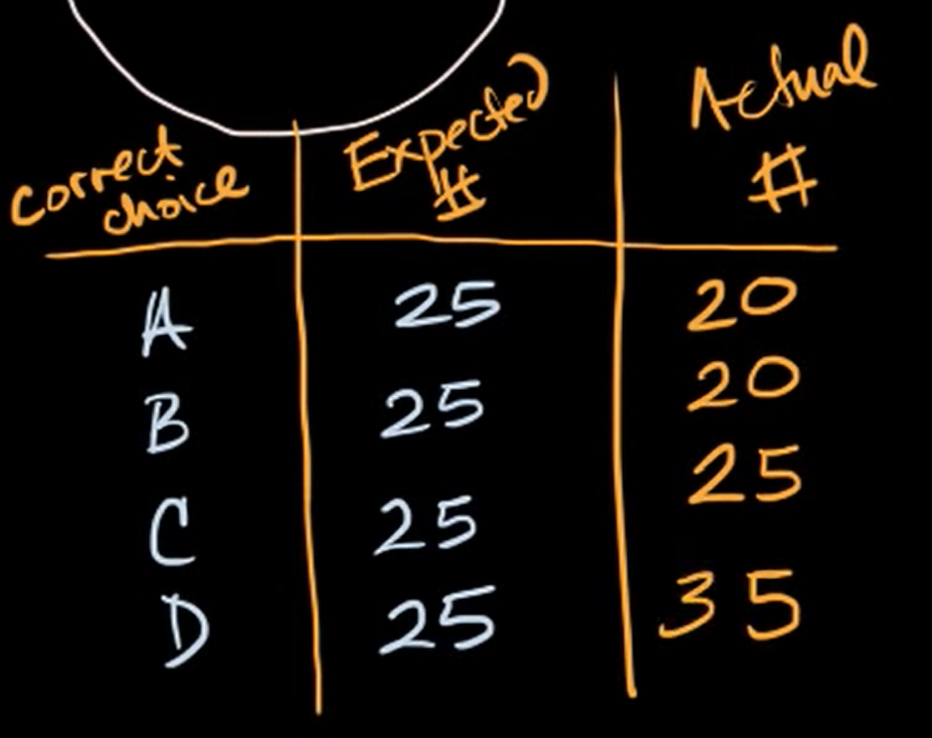

Conducting a Study – Analysing Data
Types of data
Numeric data
Continuous, discrete, or interval (each possible value has equal distance)
Categorical data
Binary (2 possibilities only), ordinal (can be ordered eg slow, medium, fast), or nominal (cannot be ordered)
Analysising categorical data using chi-squared test
Tests if two categorical variables are related
$Χ^{2}= \sum{{\left(\frac{observed value−expected value}{expected value}\right)}^{2}}$
Can refer to the chi-squared distribution to calculate ‘p-value’ of observed results

